Slide 1

REINFORCEMENT LEARNING
CONTINUOUSLY ADAPTIVE CONVERGENCE TO DRIVE THE BEST ACTIONS
John Hebeler, PhD
Lockheed Martin Fellow john.w.hebeler@lmco.com
jhebeler@gmail.com

Slide 2
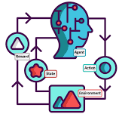

Agenda
RL Applied
RL Defined and Compared
RL Vocabulary
RL Types
RL Demonstrations
Summary
Presentation and Code available at github.com:JWHPortfolio/RLTalk.git

Slide 3
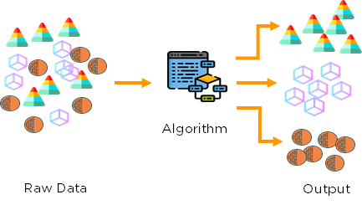
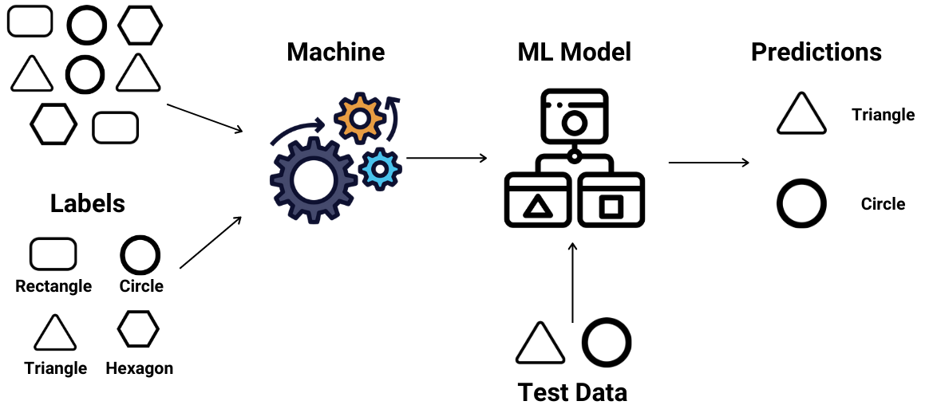
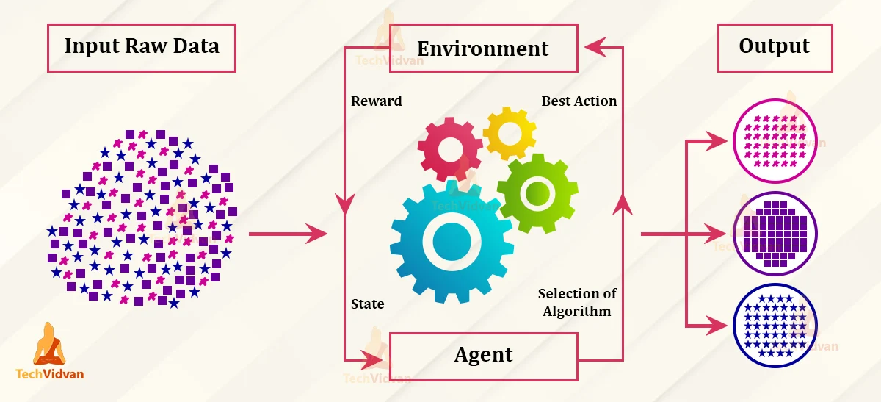
ML Types
Notes:
RL: Supervised with delayed label, Learn from experience - no new knowledge, trial and error, adopt to uncertain, dynamic environments
Examples where RL is more effective: Games, robot deciding conflicting actions, and recommendation systems, self-driving cars
Limits on RL: Extensive training, Not easy or very expensive to simulate some environments (car), real environments too risky And it is a simulation which is only an approximation
Actions may not be discrete
Optimization for a local minima is harder than ordinary DL

Slide 4

RL Vocabulary
Environment
Agent
Action Space
Explore or Exploit
State (Observation Space) and Done State
Reward or Punishment
Policy
Plan
Episode
Goal
https://gymnasium.farama.org/
Notes:
Environment - rules and surrounding info Think of a checker board
Policy - strategy to achieve the goal for example random policy
Plan - collection of policies/actions taken so far
Episode - agent reaches done or dead state (maximum number of actions)
Explore - take random action
Exploit - take best action of known possibilities

Slide 5
Limitations
Training on Simulators
Actions may not be discrete
Optimizations for local minima is harder than DL

Slide 6

Key Question in Designing RL
How do I define a goal and a reward?
How do I make the agent act?
How do I model the environment?
How do I determine the current state?
Exploration-Exploitation Trade-Off?

Slide 7
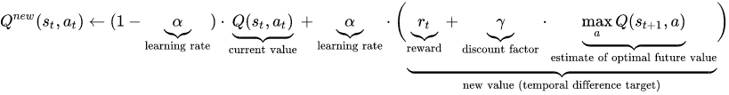
Traditional Types
Q Learning
Off Policy
Fast Learner, High Risk of Failing, Use if cost of error is not high
SARSA (State 1, Action 1, Reward, State 2, Action 2)
On Policy
Slow Learner, Low risk of Failing, Use if cost of error is high

Slide 8
Q Learning
Epsilon (0-1) - Explore or Exploit (Raise to exploit more as things are figured out)
Alpha (0-1) - Learning Rate (Balance between new state value and previous ones)
Gamma (0-1) - Discount Factor (Increases earlier states significance)
Q-Learning Equation:
Episodes? - When table converges
What if learning rate is 0 or 1 - what will happen?

Slide 9
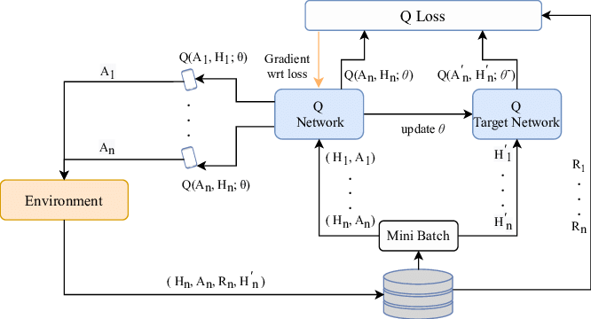
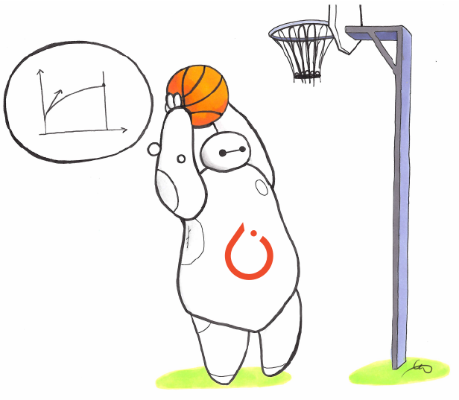
Deep Reinforcement Learning
Allows unlimited actions and action spaces
DQN
Policy Network and Target Network
Replay Memory List of [[State, Action, Reward, New State],...,]
Complete Experience
Loss between Q-Values and Target Q-Values

Slide 10
Improving Your Results
Train Longer
Hyperparameter Tuning
Different Algorithms

Slide 11
Available Environments and More…
https://gymnasium.farama.org/environments/toy_text/cliff_walking/
https://medium.com/@mlblogging.k/15-awesome-reinforcement-learning-environments-you-must-know-a38fb75867f2
https://medium.com/@mlblogging.k/15-awesome-reinforcement-learning-environments-you-must-know-a38fb75867f2
https://towardsdatascience.com/create-your-own-reinforcement-learning-environment-beb12f4151ef
https://neptune.ai/blog/the-best-tools-for-reinforcement-learning-in-python
https://pytorch.org/tutorials/intermediate/reinforcement_ppo.html
https://stable-baselines3.readthedocs.io/en/master/guide/algos.html

Slide 12

Demonstrations
Environment
Local Hardware and Software
Clouds
Google CoLab
AWS Sagemaker
MS Azure
Q-Learning (Drop Game)
Deep Learning (Blackjack)

Slide 13
Summary
Powerful Complement to Other ML Methods
Powerful Environments Available
Get your hands into it
Thank you! john.w.hebeler@lmco.com

